Slide 1
2D Transformation (Part-2)
Course Code: CSC 3224
Course Title: Computer Graphics
Dept. of Computer Science
Faculty of Science and Technology
Lecturer No: | 07 | Week No: | 06 | Semester:
Lecturer: | Md Masum Billah, billah.masumcu@aiub.edu, masum-billah.net

Slide 2
Exercise on Previous Topics
2D Translation (Problem Solving)
2D Rotation(Problem Solving)
2D Scaling (Problem Solving)
Reflection
Shearing

Slide 3
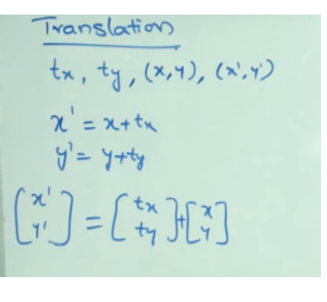
Problem Solving Transformation (Translation)

Slide 4
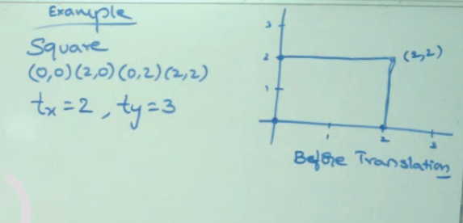
Question

Slide 5
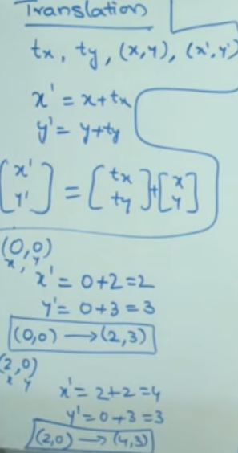
Problem Solving(Translation)

Slide 6
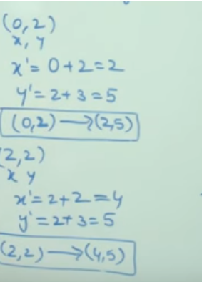
Problem Solving(Translation)

Slide 7
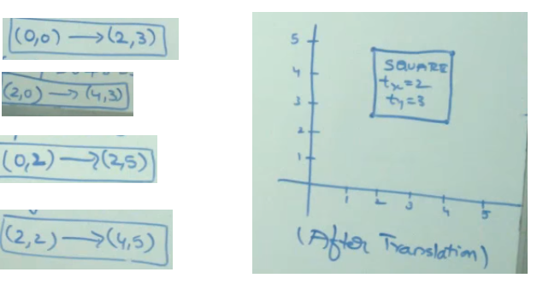
Problem Solving(Translation)

Slide 8
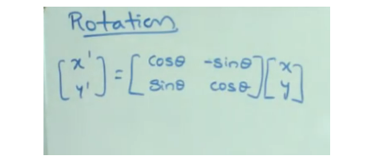
Problem Solving (Rotation)

Slide 9
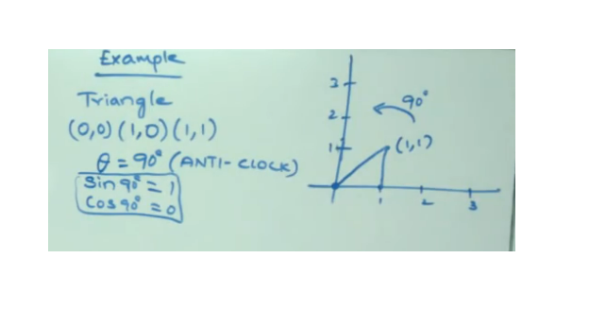
Problem Given (Rotation)

Slide 10
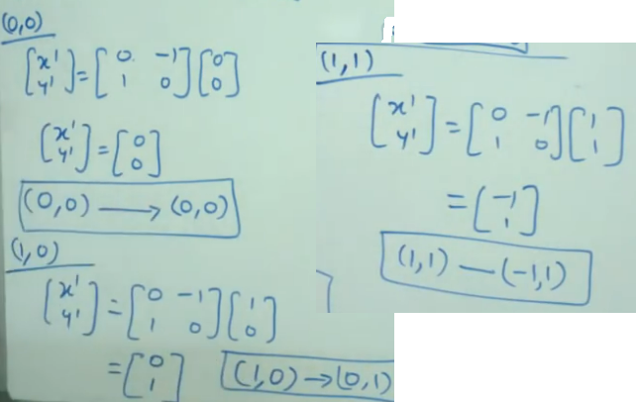
Problem Solving(Rotation)

Slide 11
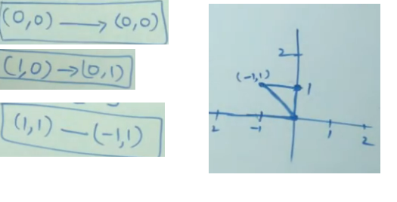
Problem Solving(Rotation)

Slide 12
Your Task
Your Task is Clockwise Rotation for previous problem

Slide 13
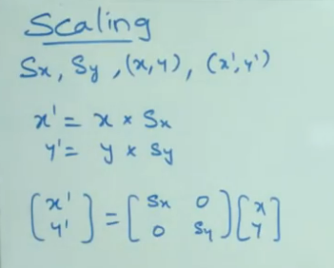
Problem Solving (Scaling)
Formula

Slide 14
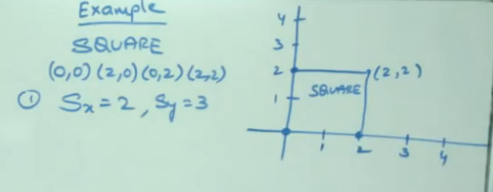
Question Given

Slide 15
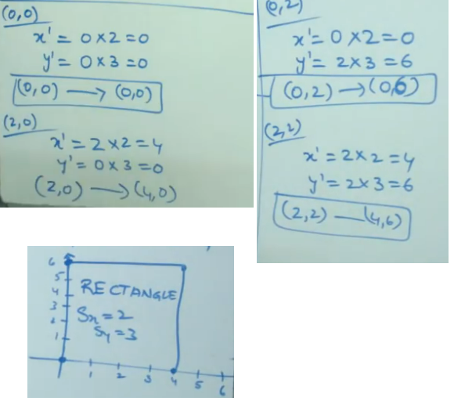
Problem Solving(Scaling)

Slide 16
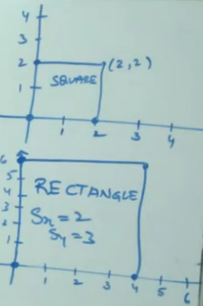
Problem Solving(Scaling)

Slide 17
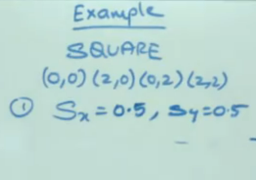
Your task?

Slide 18
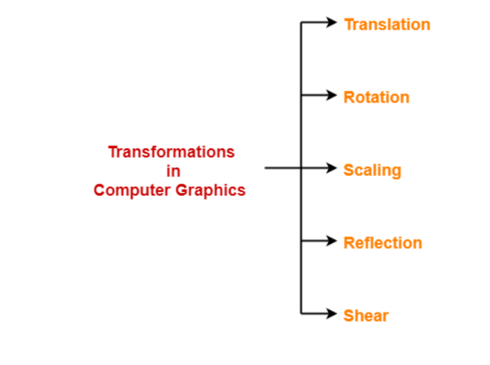
Transformation

Slide 19
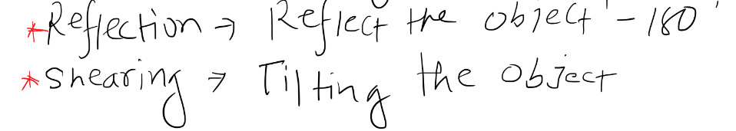
Reflection and Shearing

Slide 20
2D Reflection
Reflection is a kind of rotation where the angle of rotation is 180 degree.
The reflected object is always formed on the other side of mirror.
The size of reflected object is same as the size of original object.

Slide 21
2D Reflection
Consider a point object O has to be reflected in a 2D plane.
Let, Initial coordinates of the object O = (X_{old}, Y_{old})
New coordinates of the reflected object O after reflection = (X_{new}, Y_{new})

Slide 22
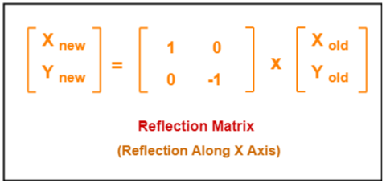
Reflection On X-Axis:
This reflection is achieved by using the following reflection equations-
X_{new} = X_{old,} Y_{new} = -Y_{old}
In Matrix form, the above reflection equations may be represented as-

Slide 23
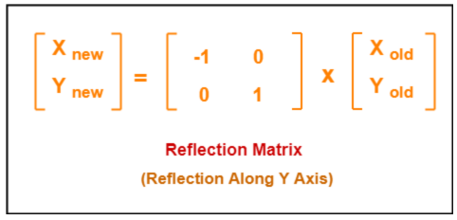
Reflection On Y-Axis:
This reflection is achieved by using the following reflection equations-
X_{new} = -X_{old,} Y_{new} = Y_{old}
In Matrix form, the above reflection equations may be represented as-

Slide 24
2D Shearing
In a two dimensional plane, the object size can be changed along X direction as well as Y direction.
So, there are two versions of shearing-
1. Shearing in X direction
2. Shearing in Y direction

Slide 25
2D Shearing
Consider a point object O has to be sheared in a 2D plane.
Let- Initial coordinates of the object O = (X_{old}, Y_{old})
Shearing parameter towards X direction = Sh_{x}
Shearing parameter towards Y direction = Sh_{y}
New coordinates of the object O after shearing = (X_{new}, Y_{new})

Slide 26
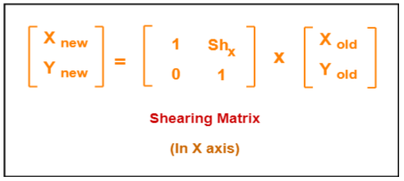
Shearing On X-Axis
Shearing in X axis is achieved by using the following shearing equations-
X_{new} = X_{old} + Sh_{x} x Y_{old} Y_{new} = Y_{old}
In Matrix form, the above shearing equations may be represented as-

Slide 27
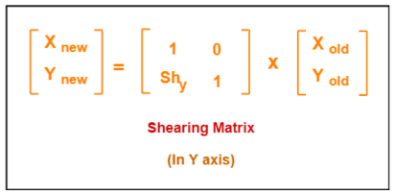
Shearing On X-Axis
Shearing in Y axis is achieved by using the following shearing equations-
X_{new} = X_{old} Y_{new} = Y_{old} + Sh_{y} x X_{old}
In Matrix form, the above shearing equations may be represented as-

Slide 28
Books
Foley, van Dam, Feiner, Hughes, Computer Graphics: principles and practice, Addison Wesley, Second Edition.
Schaum's Outline of Theory & Problems of Computer Graphics.
Peter Shirley Steve Marschner , “Fundamental of computer graphics”, Third Edition.

Slide 29
References
https://www.gatevidyalay.com/2d-reflection-in-computer-graphics-definition-examples/https://en.wikipedia.org/wiki/Transformation_matrix
https://www.gatevidyalay.com/2d-shearing-in-computer-graphics-definition-examples/
https://www.javatpoint.com/computer-graphics-2d-transformations
Chapter 5: Foley, van Dam, Feiner, Hughes, Computer Graphics: principles and practice, Addison Wesley, Second Edition

